Slide 1
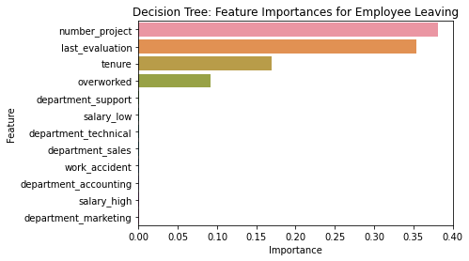
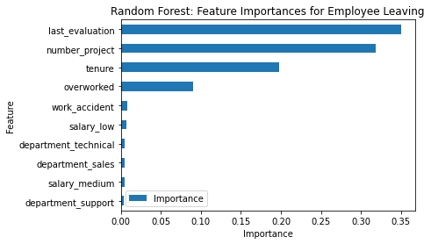
Salifort Motors
Employee Retention Project
Salifort Motors seeks to improve employee retention and answer the following question:
What’s likely to make the employee leave the company?
Since the variable we are seeking to predict is categorical, the team could build either a logistic regression or a tree-based machine learning model.
The random forest model slightly outperforms the decision tree model.
Barplot above shows the most relevant variables: ‘last_evaluation’, ‘number_project’, ‘tenure’ and ‘overworked’.
This model helps predict whether an employee will leave and identify which factors are most influential. These insights can help HR make decisions to improve employee retention.
In the random forest model above, `last_evaluation`, `tenure`, `number_project`, `overworked`, `salary_low`, and `work_accident` have the highest importance. These variables are most helpful in predicting the outcome variable, `left`.
Cap the number of projects that employees can work on.
Consider promoting employees who have been with the company for at least four years, or conduct further investigation about why four-year tenured employees are so dissatisfied.
Either reward employees for working longer hours, or don't require them to do so.
If employees aren't familiar with the company's overtime pay policies, inform them about this. If the expectations around workload and time off aren't explicit, make them clear.
Hold company-wide and within-team discussions to understand and address the company work culture, across the board and in specific contexts.
High evaluation scores should not be reserved for employees who work 200+ hours per month. Consider a proportionate scale for rewarding employees who contribute more/put in more effort.

Slide 2
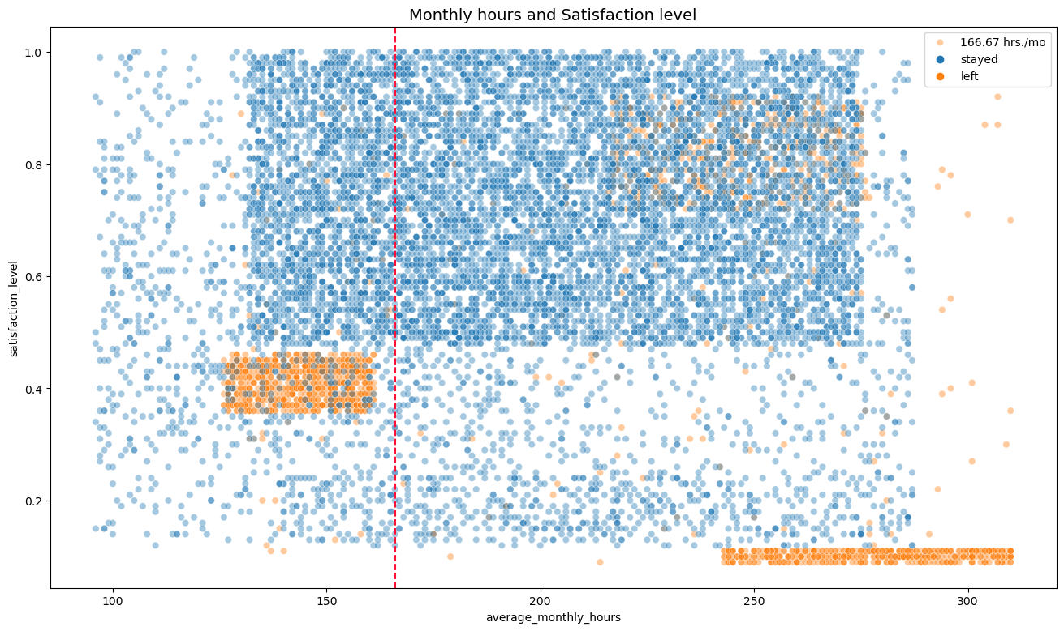
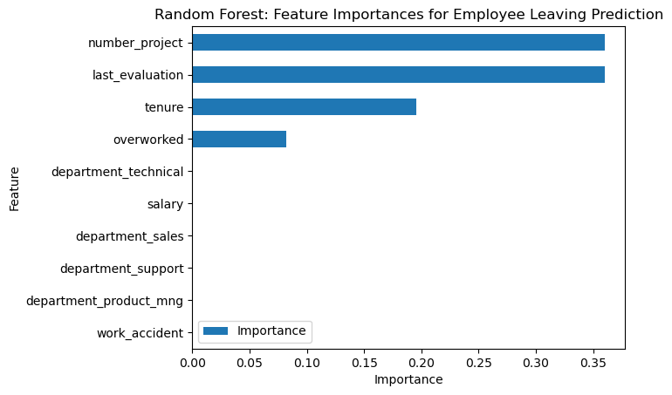
Salifort Motors
Employee Retention Project
Sailfort Motors has been experiencing a high turnover rate of employees . The company wants to identify ways to improve employee retention and identify what causes employees to leave.
For a categorical response, the team built a linear regression model, decision tree and random forest. Results were evaluated and the random forest was the champion model.
The EDA and feature importances were also interpretted for valuable insights.
From the EDA, the scatterplot shows the decrease in satisfaction as more monthly hours were rendered. Leavers were grouped according to likely reasons (full insights on the Jupyter Notebook).
The random forest model performed great on the test data and is able to predict leavers based on the given data. Feature Importances also give great insight on courses of action to take to retention.
The champion model, in the random forest model above, showed, `number_project`, `last_evaluation`, `tenure`, `overworked`, have the highest importance. These variables are most helpful in predicting the outcome variable, `left`.
Workload - Equally distribute workload between workers, (between 3-4 projects only).
- Reduce monthly hours rendered, through automation, improved systems or workflow
- Conduct interviews on most time consuming areas of work.
- Make sure new employees understand hourly expectations before hiring.
- Reward employees working overtime via pay, benefits or bonus.
Evaluation - Identify effect of low evaluation to quitting, is pay reduced? Does this lead to firing?
- Avoid reserving high evaluation for 200+ hrs rendered, consider a bonus or incentive system instead.
- Utilize model to predict potential leavers, and create an intervention/reward program for employees.
Identify Causes - Identify via interviews, cause for lower satisfaction on tenures 5-6, and leaving in year 4.
- Consider promoting or salary increase for on their 4th year (at ensure promotion within 5 years).
- Conduct internal surveys, FGDs and team meetings to check on employees workload and well-being.

